Slide 1
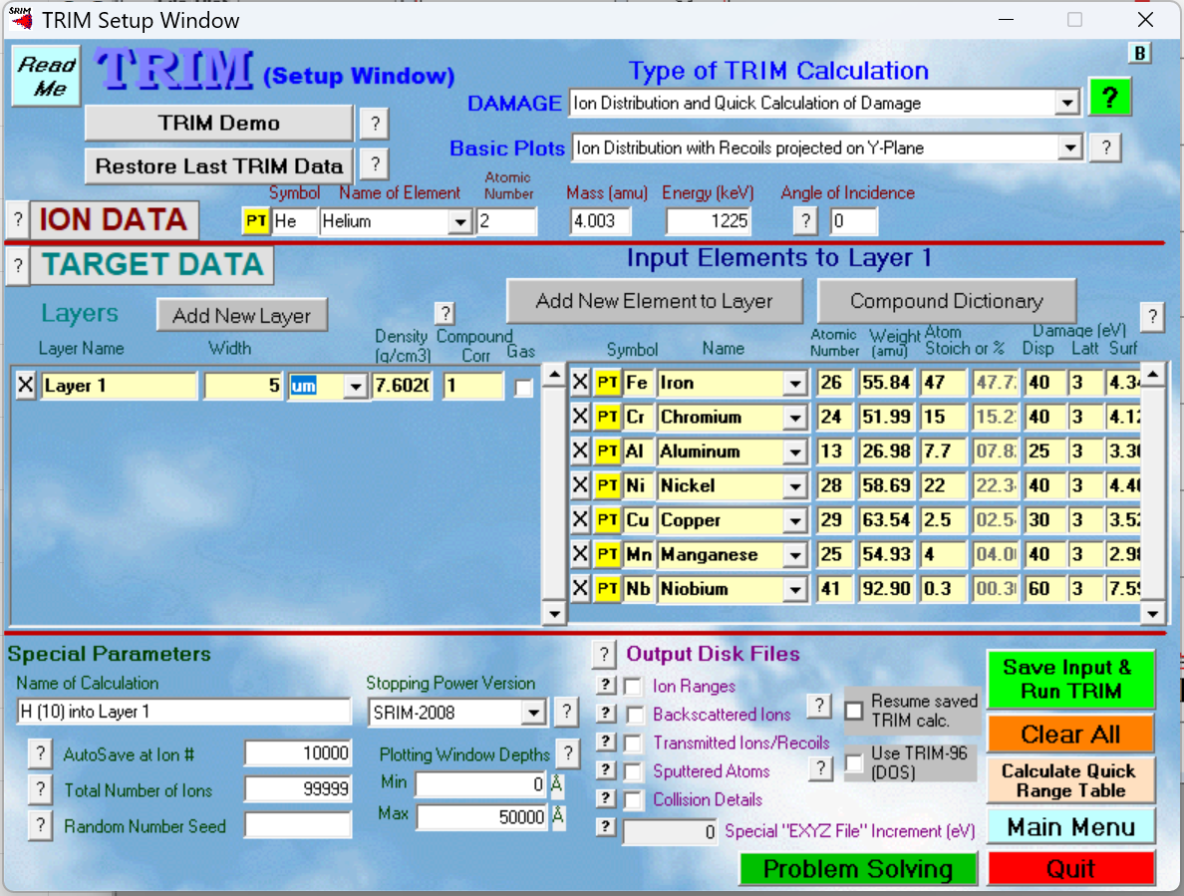
He parameters:
6 energy from highest to lowest: 1525, 1225, 925, 625, 325, and 145 keV.

Slide 2
